Slide 1
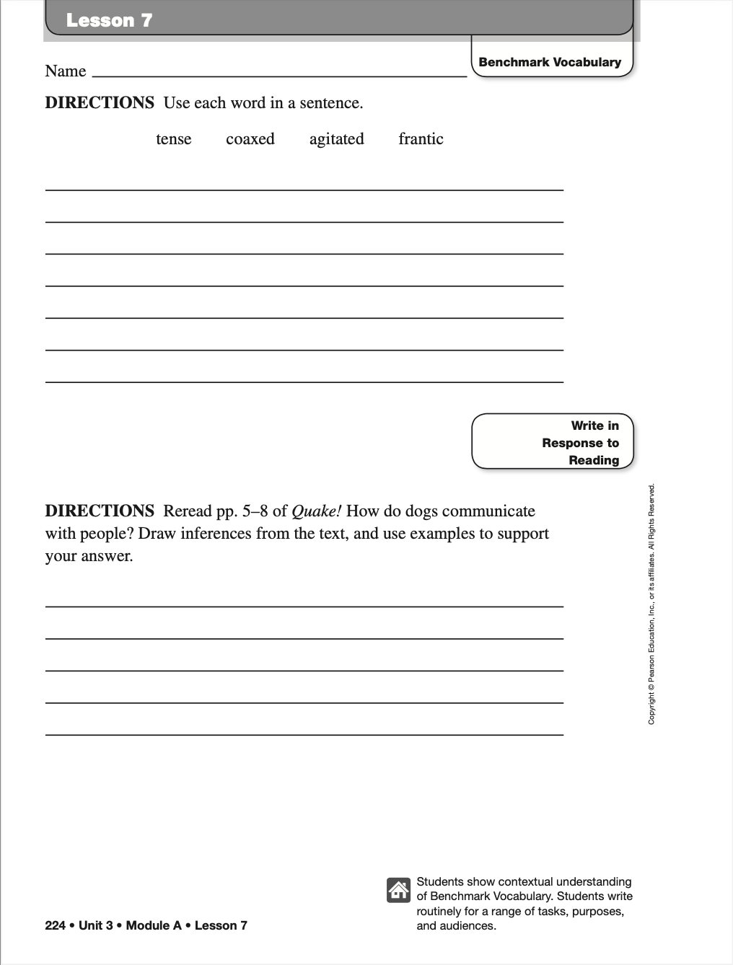

Lesson 1 Chapters 1-2
peculiar:
dilemma:
ancient:
petrified:
DIRECTIONS: In chapter 1 of Aidan of Oren, Alan St. Jean writes about Aidan’s dream. How was this dream different from Aidan’s usual dreams? Use examples from the text to support your answer.
Page 1

Slide 2
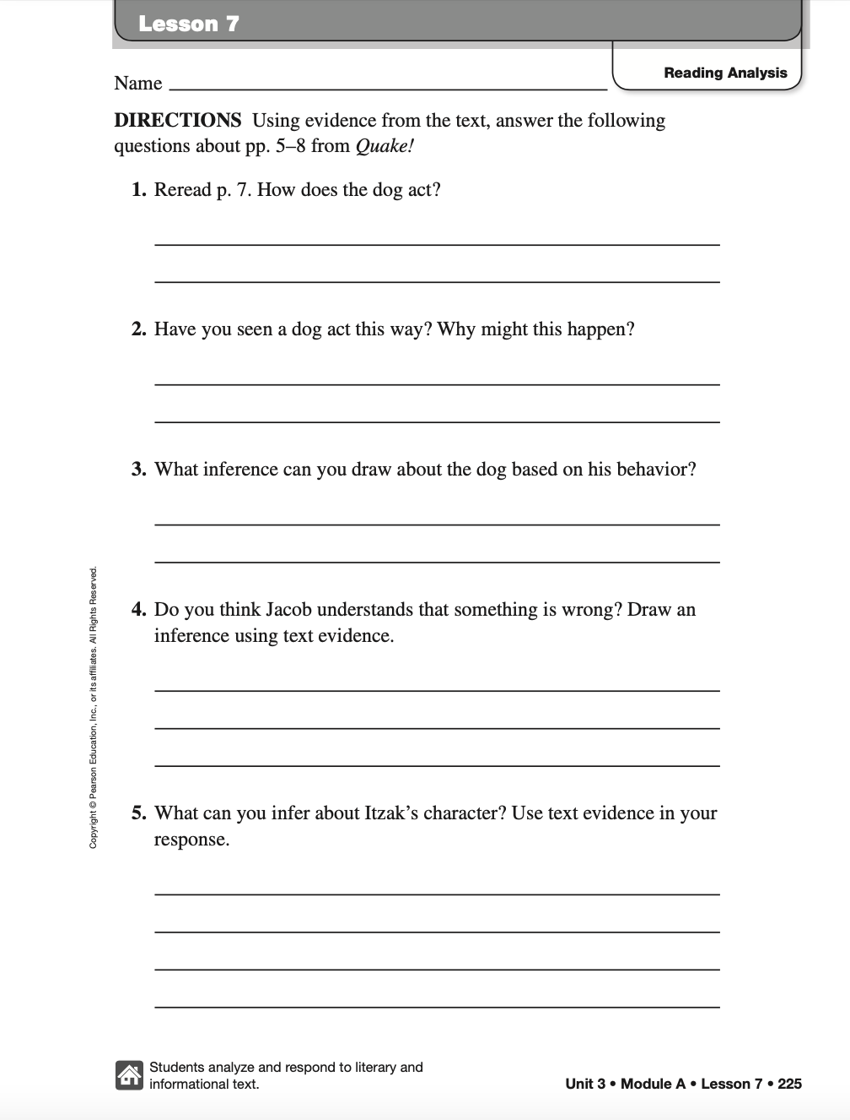


Lesson 1
Lesson 1 Chapters 1-2
Aidan of Oren.
Draw a picture of Aidan’s dream.
Describe the setting. (Location, season, country, etc.)
How does Grandmama react to Aidan’s dream?
Why do you think Aidan is petrified of the well?
What do you think will happen next?
Page 2

Slide 3
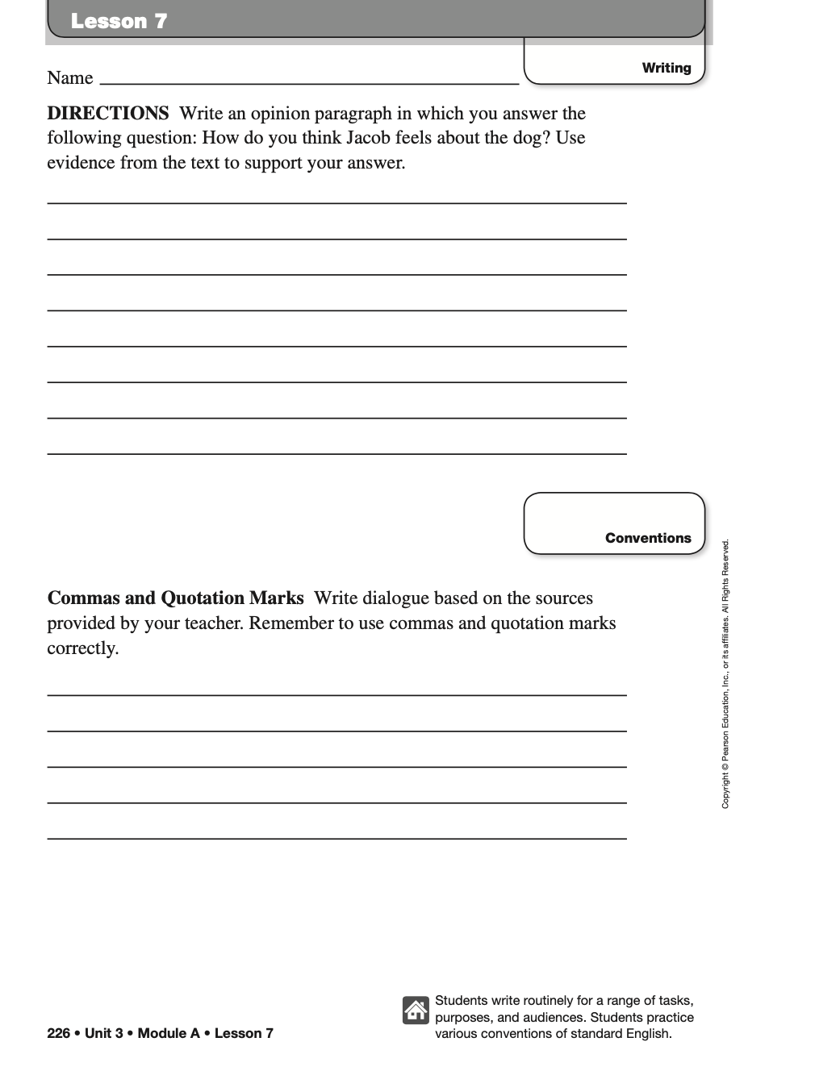
Lesson 1
Lesson 1 Chapters 1-2
Directions Write an opinion paragraph in which you answer the following question: What kind of a person is Grandmama?
Commas and Quotation Marks Write a dialogue between you and your friend telling him or her about a dream you’ve had. Remember to use commas and quotation marks correctly.
Page 3

Slide 4
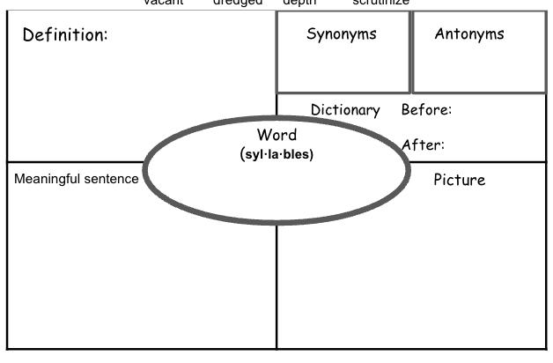
Lesson 2 Chapters 3-4
Choose two vocab words to complete the vocab boxes.
aroma maturity mussed treacherous
Page 1

Slide 5
Lesson 2
Lesson 2 Chapters 3-4
Aidan of Oren.
Draw a picture of Charles.
Describe the mood of chapter 3? How does it contrast with chapter 4?
What are some examples of humor in chapters 3-4?
Describe Lily.
Why did the earth begin to quake in the market?
Page 2

Slide 6
Lesson 3 Chapters 5-8
Choose two vocab words to complete the vocab boxes.
compassion unyielding gruesome prophecy
Page 1

Slide 7
Lesson 3
Lesson 3 Chapters 5-8
Aidan of Oren.
Draw a picture of McKenzie’s gift. .
Describe the Legend of Gorgon.
Why is the title of chapter 5 “True Courage”?
Describe Lily.
What do you think the prophecy means?
“When the hooded man first appears, a child will arise of thirteen years. A child of fire, of Oren pride Wisdom and a warrior, at his side. To travel up the way of sorrow, as longest day is nigh the morrow. From elves to learn the ancient ways, and secrets told from yonder days. Destined to set the guardians free, to harvest peace from sea to sea.”
Page 2

Slide 8
Lesson 4 Chapters 9-10
Complete the vocab boxes.
destiny craftsmanship
des*tin*y
crafts*man*ship
Page 1

Slide 9
Lesson 4
Lesson 4 Chapters 9-10
Aidan of Oren.
Draw a picture of the Dragon Chest.
Describe how elves communicate.
Why is McKenzie’s gift priceless?
What do you think the wish poem means?
Describe Lily.
Make a little wish, hold it in your hand; kneel to the ground, and rub it in the sand. Look up to the heavens, and there pronounce your name. The wind will grant your wish, but you’ll never be the same.
Page 2

Slide 10
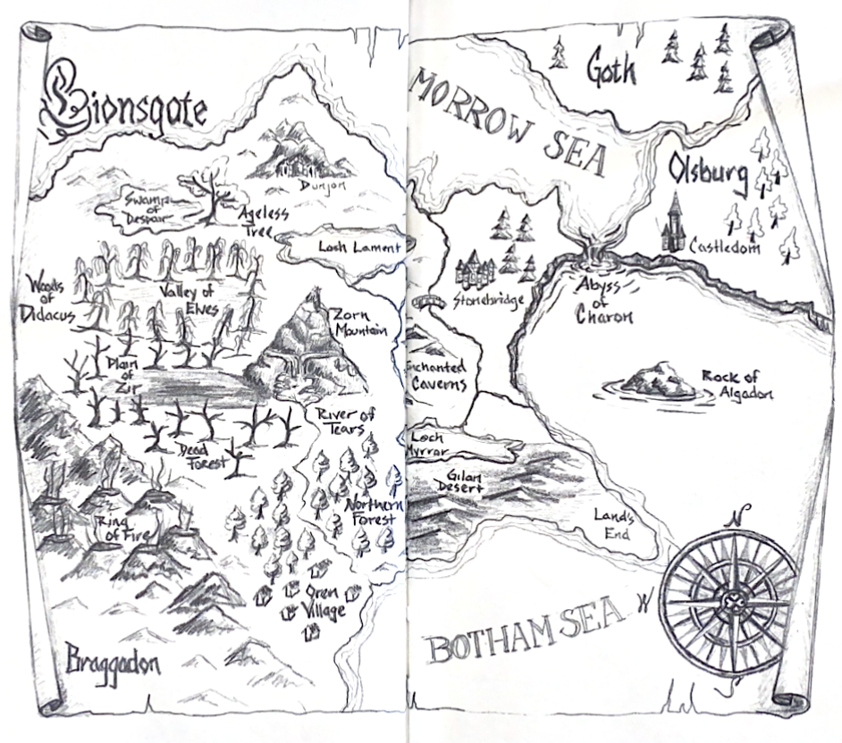
Lesson 5 Chapters 11-12
Directions: Study the Map.
Color the water blue (seas, lochs, and rivers), the living forests green, and the Valley of the Elves purple. Feel free to add other details as well.
DIRECTIONS: In chapter 1 of Aidan of Oren, Alan St. Jean writes about Aidan’s dream. How was this dream different from Aidan’s usual dreams? Use examples from the text to support your answer.
Page 1

Slide 11
Lesson 5 Chapters 11-12
Choose two vocab words to complete the vocab boxes.
guardian potential
guar*di*an
po*ten*tial
Page 2

Slide 12
Lesson 5
Lesson 5 Chapters 11-12
Aidan of Oren.
Draw a picture of what you think a
guardian looks like.
Describe Aidan’s parents.
Why does Grandmama tell Aiden he is special?
When can Aidan find the elves?
What do you think will happen next?
Page 3

Slide 13
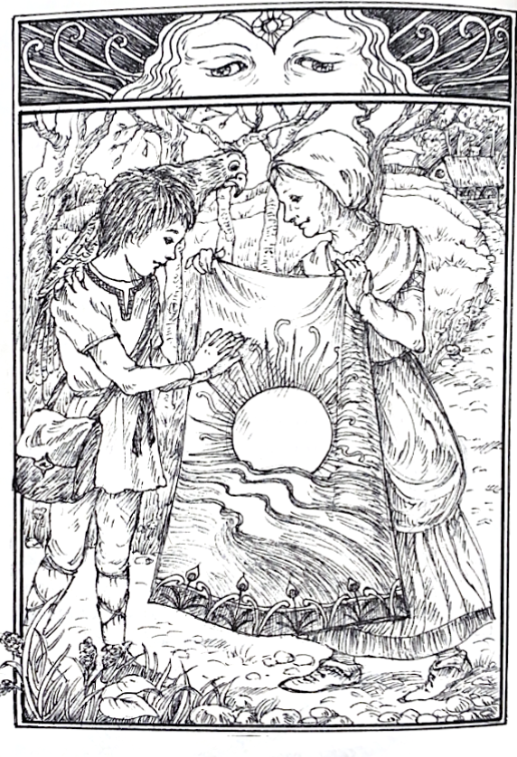
Lesson 6 Chapters 13-14
Directions: Color the scene.
“This quilt was made by your mother before you were born. She made it for you, Aidan. The emblem in the center represents the rising sun against the horizon.”
DIRECTIONS: In chapter 14, Explain why Aidan shared, “They say the mountain is sad.”
Page 1

Slide 14
Lesson 6 Chapters 13-14
Complete the vocab boxes.
emblem wasteland
em*blem
waste*land
Page 2

Slide 15
Lesson 7 Chapters 15-16
Write the meaning of each word.
Hideous:
Misshapen:
Ordeal:
Sanctuary:
DIRECTIONS: In chapter 15 of Aidan of Oren, Alan St. Jean writes about the trolls. How did Aidan save his friends from the trolls? Use examples from the text to support your answer.
Page 1

Slide 16
Lesson 7
Directions At the end of chapter 15 in Aidan of Oren, Alan St. Jean writes, “The wish poem was right – he would never be the same.” Describe what the author means by this statement.
llustrate the following paragraph.
The river turned sharply to the left, and the forest ended, giving way to twin waterfalls, each jutting out of rocky caverns forming the base of the mountain. The waterfalls poured toward each other and exploded onto a massive pile of boulders, creating an eerie mist.
Page 2

Slide 17
Lesson 8 Chapters 17-18
Venture:
Regal:
Incredible:
Telepathy:
DIRECTIONS: In chapter 17 of Aidan of Oren, Alan St. Jean writes about a sea serpent named Kartha. How did Aidan escape Kartha? Use examples from the text to support your answer.
Page 1

Slide 18
Lesson 8
Lesson 8 Chapters 17-18
Aidan of Oren.
Draw a picture of Kartha.
Describe Bernard.
Why is Charles upset in these chapters?
McKenzie has an Aha Moment at the end of chapter 18. She shared, “No wonder the Hall of Judges is so big.” What does she discover about the guardians?
What do you think will happen next?
Page 2

Slide 19
Lesson 9 Chapters 19-20
Name ______________________________________
Mark on the map where you think the children are right now. Label where you think Sorrow’s Way is on the map.
“Here is Oren, and this curved line heading up from there is Sorrow’s Way. That’s the path we took today.”
Color the Ring of Fire by making the mountains look like volcanoes.
Circle where Lilly was born. Add the islands she is describing.
She slowly moved her hand to the far right side of the map, her finger stopping where the land formed a great gulf, meeting the sea.
“This is Land’s End. This is where I was born…There are islands out here. They don’t show on the map, but they’re there. I remember being taken out in the fishing boats.”
2.
3.
Page 1

Slide 20
Lesson 9
Aidan of Oren.
Draw a picture of the Great Sitting Rock.
What do you think Grock means,
“Beware, Aidan of Oren, the mind’s eye is easily deceived. Seek the inner beauty”?
3.
What is Aidan most worried about?
4.
What question(s) would you like to ask the Great Sitting Rock?
Page 2

Slide 21
Lesson 10 Chapters 21-22
Astonished:
Indignant:
Dismay:
Delicate:
DIRECTIONS: In the book Aidan of Oren, Alan St. Jean writes a chapter named “Diamonds.” Summarize this chapter. Be sure to include the key points of the chapter.
Page 1

Slide 22
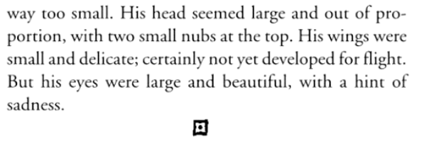
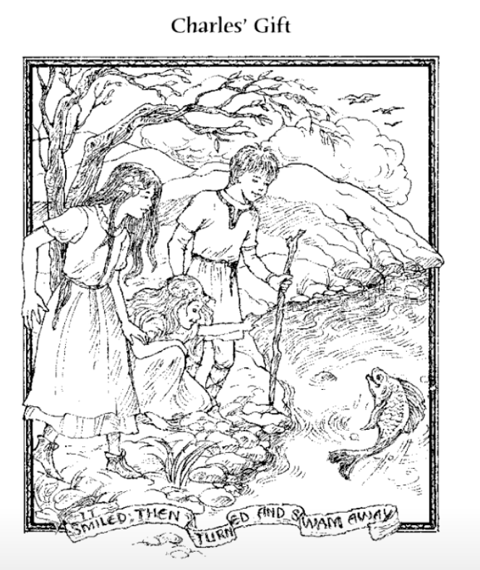
Lesson 10
Lesson 10 Chapters 21-22
Aidan of Oren.
Draw a picture of the dragon based on Alan St. Jean’s description.
2. Color the illustration.
Write a caption to go with the
picture.
Caption
____________________________________________________________________________________________________________________________________________________________
Page 2

Slide 23
Lesson 11 Chapters 23-24
Choose two vocab words to complete the vocab boxes.
pendant landmark sojourn self-doubt
Page 1

Slide 24
Lesson 11 Chapters 23-24
Lesson 11
Aidan of Oren.
Draw a picture of Lilly’s basket.
What do you think Aidan’s Grandmama meant when she advised, “The future is what you make it.”
3.
What is Lilly most worried about?
4.
What did McKenzie give to Aidan to help him not be afraid? Do you think it will help?
Page 2

Slide 25
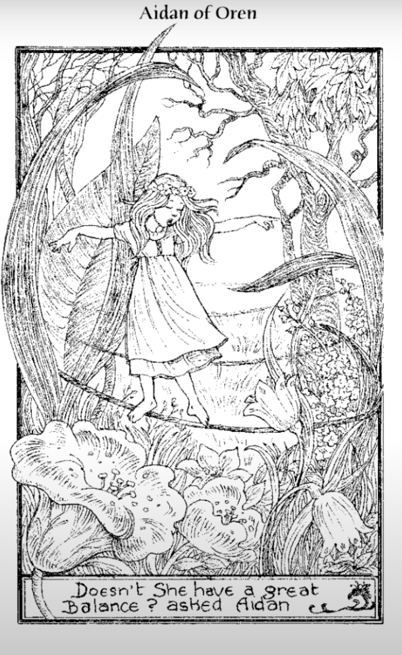
Lesson 12 Chapters 25-26
Aidan of Oren.
Sketch the next scene. Add details and a caption.
3.
What is Lilly most worried about?
2.
How did Damon help Charles?
Page 1

Slide 26
Lesson 12 Chapters 25-26
Choose two vocab words to complete the vocab boxes.
marvelous strand charbroiled cooing
Page 2

Slide 27
Lesson 13 Chapters 27-28
Shunned:
Disperse:
Restore:
Stump:
Signpost: Contrast
DIRECTIONS: In Aidan of Oren, Alan St. Jean writes about a Prince from Goth. How did he change? Use examples from the text to support your answer.
Page 1

Slide 28
Lesson 13
Lesson 13 Chapters 27-28
Aidan of Oren.
Draw the tree stump.
Describe Gorgon.
Where did Aidan get his AHA Moment from to help Gorgon?
How did the imp help?
Explain what the moon had to do with this chapter?
Page 2

Slide 29
Lesson 14 Chapters 29-30
Aidan of Oren.
Draw a picture of Sebastian Fry.
Describe Aidan’s dream at the end of the book. .
Do you think Aidan will find his father?
Give examples of how Alan St. Jean used the writing strategy Full-Circle.
Describe Lily.
Page 1

Slide 30
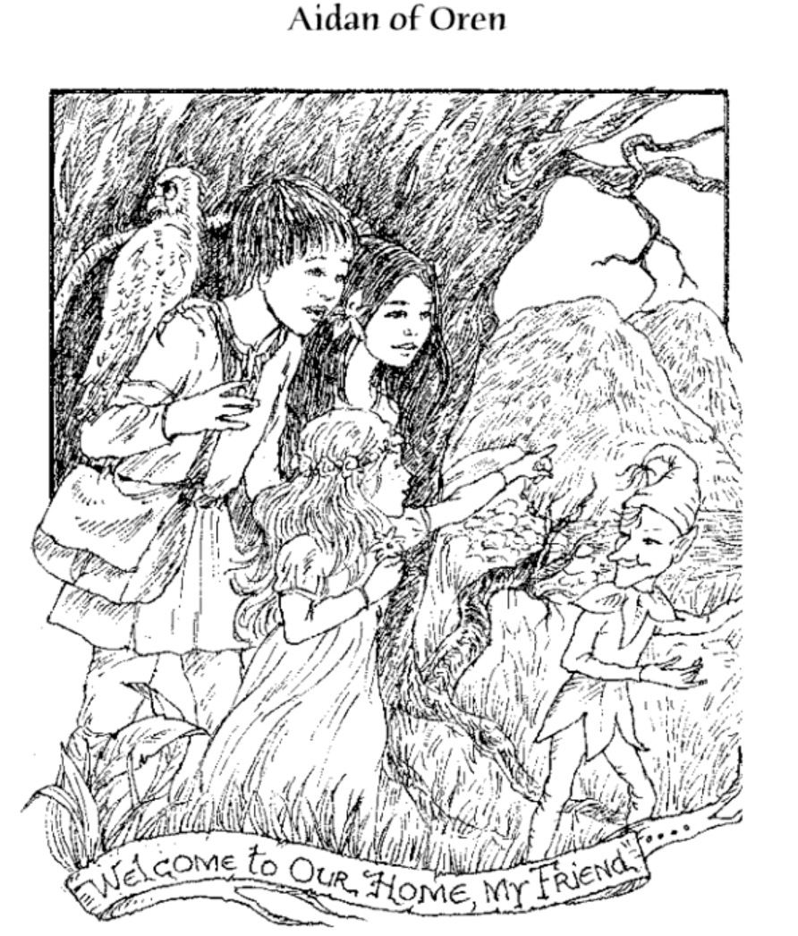
Lesson 14 Chapters 29-30
Choose a new word from Aidan of Oren that you learned It can be from any chapter..
What should the last illustration for the book be?
Page 2

